Slide 1
Academic Integrity @
TMU
Kris Erickson, PhD
Academic Integrity Specialist, AIO

Slide 2

Clarifying the AIO’s Role
What we do
Support fairness within Policy 60 processes and procedures
Support individual growth and cross-campus capacity building about academic integrity
Encourage awareness of rights and responsibilities
Academic Integrity as a strength
What we don’t do
Take sides to shape decisions or control outcomes
Obscure knowledge or understanding about academic integrity
Raise obstacles or barriers to academic integrity
Academic Misconduct as a risk

Slide 3
Creating a Culture of Academic Integrity: Our Shared Responsibility & Fundamental Values
Honesty
Trust
Honesty
Trust
Fairness
Respect
Responsibility
Courage
Courage
Fairness
Respect
Responsibility
(International Centre for Academic Integrity, 2021; Toronto Metropolitan University, 2019)

Slide 4

Why Do Students Cheat?
What is the
disconnect?
?
CC0 1.0 https://www.publicdomainpictures.net/en/free-download.php?image=wireless-connection-sign&id=270897

Slide 5
Why Do Students Cheat?
Unaware this (or that) was cheating
Don’t believe they can do the work
Feel the choice is out of their control
Don’t perceive actions as wrong (not that bad)
Bertram Gallant, Tricia, and David A. Rettinger. 2025. The Opposite of Cheating: Teaching for Integrity in the Age of AI. Vol. 4. Teaching, Engaging, and Thriving in Higher Ed. University of Oklahoma Press.

Slide 6
Why Do Students Cheat?
“Moral disengagement” — neutralizing our choices
Denial of responsibility: “I didn’t mean to!” “It wasn’t my intention!”
Denial of harm / denial of the victim: “No one got hurt.” or “Everyone is doing it.” or “It won’t happen again.”
Condemnation of the condemner(s): “Professors mark on a curve.” or “The course is rigged.”
Appeals to a higher loyalty: “I was only helping a friend.”
Bertram Gallant, Tricia, and David A. Rettinger. 2025. The Opposite of Cheating: Teaching for Integrity in the Age of AI. Vol. 4. Teaching, Engaging, and Thriving in Higher Ed. University of Oklahoma Press.

Slide 7
Professional Consequences to Cheating
Using AI to help finish a big assignment
Is this professionally sustainable? Cheating through unauthorized aid → shirking personal responsibility What if it’s factually wrong? → who will your boss blame the error on: you or Chat GPT? | Are dependent actions likely to lead towards advancement and promotion? Deception / misrepresenting performance → eroding trust with your boss / supervisor / colleagues Will a supervisor (or coworker) think twice about involving you in important or meaningful assignments?

Slide 8
Professional Consequences to Cheating
Sharing / receiving project files, data, intermediate analysis
Is this professionally sustainable? Are these sources or recipients reliable, trustworthy? What if the data is factually wrong? → who will clients hold responsible for addressing and fixing errors? Your reputation is on the line | Are dependent actions likely to lead towards advancement and promotion? Ad hoc practices may produce inconsistent and unreliable results Will clients think twice about offering you important or meaningful contracts (or limit referrals to their colleagues)?

Slide 9
Why Do Students Cheat Cut Corners?
Alternatives to cheating: re-engage with your learning
Take responsibility: get informed about integrity; digital organization skills; prioritization and time management
Acknowledge (future) harm: “If I don’t manage data ethically now, future mismanagement may have more serious consequences.” (Lost funding, partnerships)
Empathize with your professor: “This is a professional in the field and know why and how these concepts are important to remember and practice.”

Slide 10
Academic Misconduct Isn’t Only Cheating…
TMU’s Policy 60 on Academic Integrity defines Academic Misconduct as:
“any behaviour that undermines the University’s ability to evaluate fairly students’ academic achievements”
or
“any behavior that a student knew, or reasonably ought to have known, could gain them or others unearned academic advantage or benefit.”
(Policy 60: Section 3)

Slide 11
Forms of Misconduct: Policy 60
Plagiarism
Cheating
Misrepresentation of personal identity or performance
Submission of false information
Contributing to Academic Misconduct
Self-plagiarism
Contract Cheating
Damaging, Tampering, Interfering with the Scholarly Environment
Unauthorized Use of Intellectual Property
Misconduct in Re-graded/Re-submitted Work
Violations of Specific Departmental or Course Requirements
← Poor scholarship ←→ misattributing, falsifying, making up sources
← violating in-person exams (Smart glasses) ←→ take-home exam rules
← unauthorized AI use
← Forged or falsified documentation (for ACRs)
← Enabling cheating (sharing materials)
← Re-using assignments ←→ submitting other students work
← paying someone else to write, in whole or in part
← Theft of exam
← Sharing a prof’s slides, materials
← “Doubling down”
← Codes, standards

Slide 12
Top Academic Integrity Tips
There are always alternative choices to cheating
Course Outlines
  Review & note key dates and expectations
Be Proactive!
  Reflect on past habits and seek help in pursuit of future goals
Ask Questions?
  Seek clarity & perspective from trusted sources

Slide 13
How Concerns of Academic Misconduct are Addressed at TMU

Slide 14
If there is a Concern or Suspicion
Brought forward by your professor or referred to the AIO by a third party (“whistleblower”)
Students are offered an opportunity to engage in a respectful, non-adversarial conversation—“So what happened?”
  Non-facilitated discussion (NFD) or Facilitated discussion (FD)
Students can consult with a student advocate (TMSU or TMAPS approved) or bring a support person
Substantiating documents are shared in advance, with both parties
Your instructor (sometimes a different professor) is your decision-maker. Decisions are made on a balance of probabilities

Slide 15
Penalties and Other Consequences
Academic Penalties
Minimum grade reduction on assessment (up to a zero)
Possible course grade reduction (if indicated on course outline)
A grade of “F” in the course
Other possibilities: disciplinary suspension (DS), withdrawal, expulsion
Students maintain a right to appeal
Educational Consequences
Educational requirements (mandatory learning workshops, quiz)
Non-completion may affect graduation or return to studies
(Senate Policy 60, Toronto Metropolitan University, 2019, Section 7, 8 and 9)

Slide 16
“What should I Do?” If there is a Concern
Make time to understand the
process & consequences
Prepare documents and files,
including version histories
Be honest, truthful, and
courageous: admit; learn
Integrity now matters for
future professional identity
Honesty
Trust
Courage
Fairness
Respect
Responsibility
(International Centre for Academic Integrity, 2021; Toronto Metropolitan University, 2019)

Slide 17
(Gen) AI and Tips for Maintaining Integrity in the AI Era

Slide 18
Tips for Maintaining Academic Integrity with AI
Pro tip: just because AI is widely available doesn’t mean it’s always allowed
Pop Quiz: Categorize the following statements: OK or Misconduct?
“If I only use it for creating my footnotes / bibliography / tables / renderings / etc., Chat GPT is fine.”
“I use AI to help me summarize my research, but then I do the writing.”
“It’s just for brainstorming / outlining, not for drafts.”
“Grammarly isn’t AI, so it’s fine.”
“I wrote everything myself: I only used AI to polish my writing / make my writing sound smarter, so it’s fine.”

Slide 19
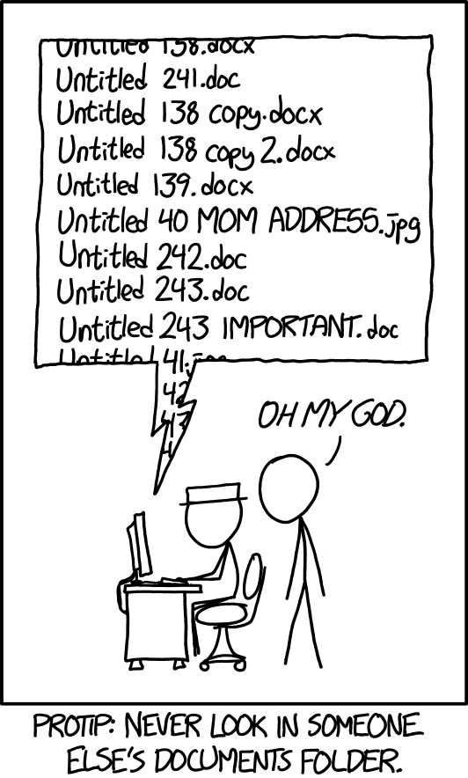
Strategies for Success
Make time for practice: there is no other way to strengthen technique / skill and avoid making unintended mistakes (impact, not intention, matters)
Articulate the purpose of quoting and attribution in research: as making evidence-based assertions (claims), not just reviewing existing knowledge
Practice attribution techniques in your writing (SLLS on integrating [APA]); organize using Zotero [TMU Library]
Stay organized! Follow naming conventions for drafts
When AI is not allowed, there is no room for negotiation: uninstall & block!
Image: xkcd. “Documents.” Shared under CC BY NC License.

Slide 20
Engagement with Academic Integrity
Academic Integrity Council (AIC) Student Representatives
Serve on AIC panels for student appeals and penalty hearings
Academic Integrity Ambassadors (AIA)
Enhance campus outreach and engagement across programs and faculties
Promote and encourage a culture of academic integrity
NOW RECRUITING! Email aio@torontomu.ca if interested!

Slide 21
Get In Touch!
Email: aio@torontomu.ca
Website: torontomu.ca/academicintegrity/
Phone: (416) 979-5000 ext. 557800
X / Twitter: @TMU_AIO
IG: @tmu.aia

